Slide 1


MEDITECH Expanse
ED Provider Training
Web Based EHR

Slide 2

Disclaimer
This PowerPoint is NOT a full training on MEDITECH Expanse
The goal is to introduce you to the EHR and introduce you to Views and Concepts
An in-Person training session is required
  Setup Access (Along with additional Applications)
  Expand on the process details
  Tailor training to the user (Surgeon/Consultant/Hospitalist etc.)

Slide 3
Table of Contents
Expanse Login
Web ED Tracker
The Chart
Document
Orders
Discharge
Slide 4
Slide 10
Slide 31
Slide 47
Slide 52
Slide 57

Slide 4
Expanse Login

Slide 5


MEDITECH Expanse
Expanse is available in 2 versions
  Desktop
    Similar to 6.15 (previous version)
    Only available version to non-Providers
  Web
    New Design
    Provider only
    Added functionality

Slide 6
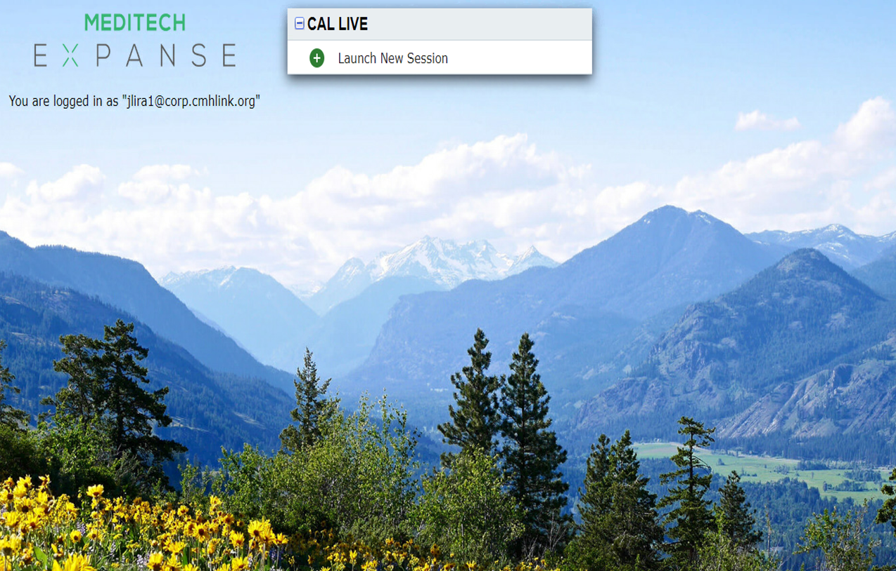

Launching into Expanse Web
Double Clicking the Expanse Web icon opens a Chrome tab (Chrome is the default browser for Expanse Web)
Click “Launch New Session” to open an Expanse Web Session

Slide 7
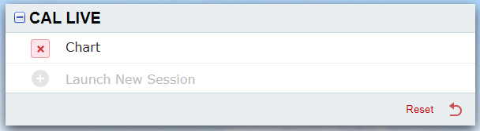
Launching into Expanse Web
If Expanse was exited incorrectly
  An option to return to previous location is offered
  That session may also be cancelled “X”, and a new session will be offered

Slide 8

Main Menu options
Options vary based on access
“Web ED Tracker”
  Launches Status Board
  Working area for Expanse
“Change Your User’s PIN”
  Change/Set your sign PIN
“Message/Task System”
  Non-Web Workload
“Facesheet Information”
  Not needed

Slide 9
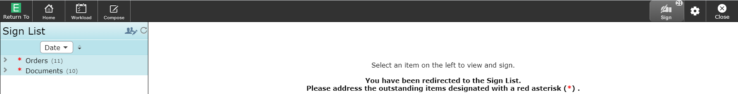
Redirect to Sign Queue
If you have items to sign, you will be redirected to your Sign Queue
  You may close, unless items are overdue
    Ordering functionality is disabled if not signed
Orders (Submit and reject options)
Documents (Submit and edit co-signers options) – Deleting is done from the chart

Slide 10
Web ED Tracker
Introduction to the Web ED Tracker

Slide 11
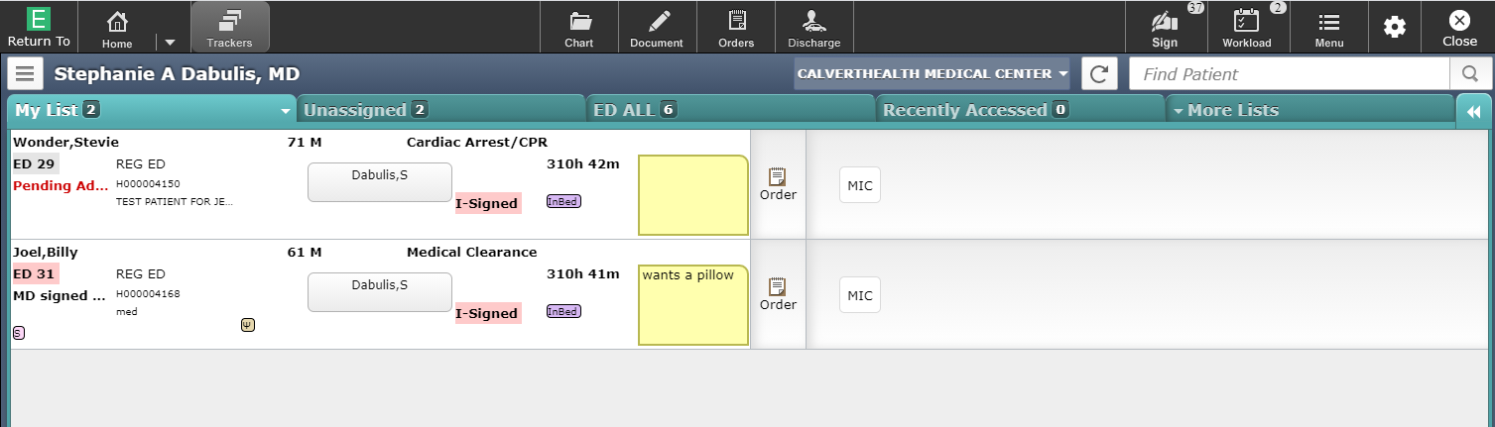
Web ED Tracker View
We will systematically review the sections of the display
“My List” is the default Tab

Slide 12
Home Screen navigation
The Navigation may alter slightly as options are chosen

Slide 13











Navigation Bar Buttons
Return To – Button allows you to close all open charts or completely out of Expanse. Failure to use the “Close All” option will leave your session open in the background and could contribute to system issues and slowness.
Home – The Home button will take you back to your list of patients (previous window still open). Option to toggle to Ambulatory/ED views
Chart – Opens the chart of the patient highlighted on the tracker
Document – Create or edit documents
Orders – Place or review orders, Reconcile, Transfer
Discharge – Universal Discharge
Sign – Sign queue, to sign orders or documents. Number in corner indicates the number to sign
Workload – Displays deficiencies, queries etc. Web version of “message/Task System”
Menu – Change PIN, Access External links, Manage Typical, launch chart Viewer Etc.
Gear Icon – “Report an Issue” to create snapshot when issue occurs (= “Shift” + “F5”)
Close – Closes displayed window. Can exit Expanse if all windows are closed this way

Slide 14


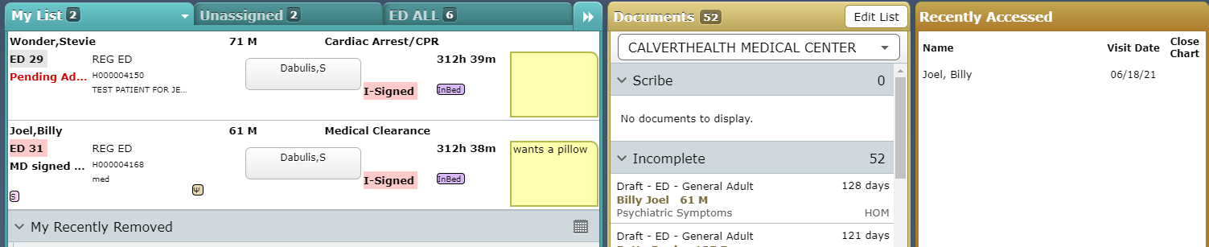
Navigation Bar Buttons
ED specific buttons/Functions
  Trackers
    Returns you to Tracker Board
  Home
    Option to toggle to Ambulatory/Acute (Inpatient) views
    Puts you on alternative Tracker view (Discussed later)

Slide 15
Provider Header
Identifies the logged in provider
Allows patients to be searched for
Refresh List
Admit Request and other options

Slide 16
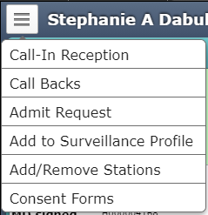
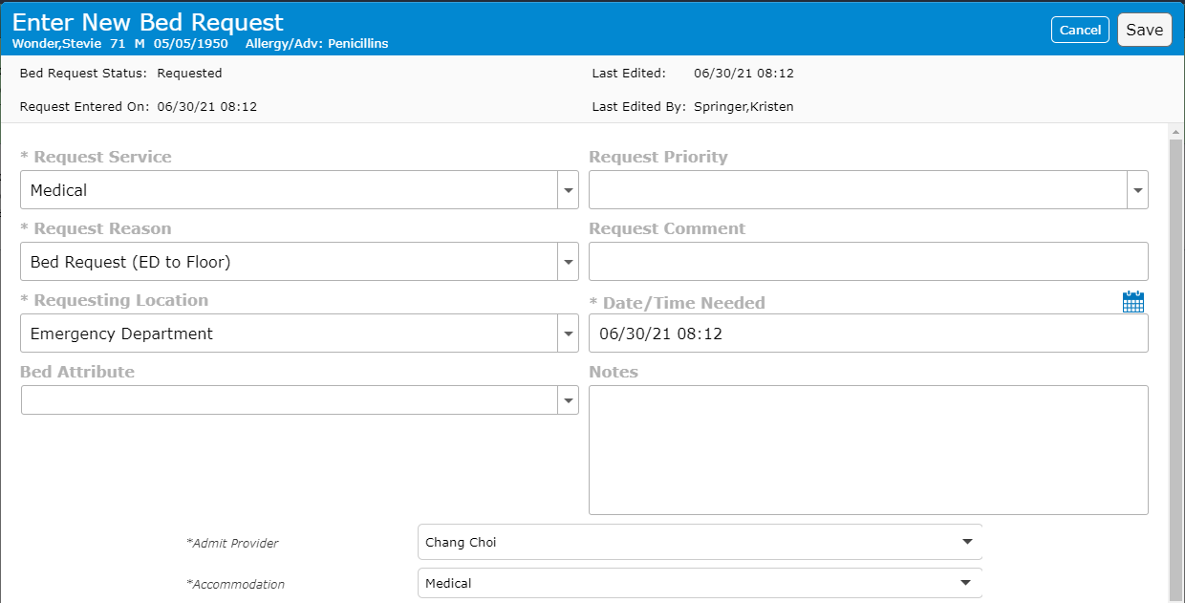
Options
While many options display
  “Admit Request” is primary option
Admit Request
  5 Required Fields
  Completed for this screen shot

Slide 17

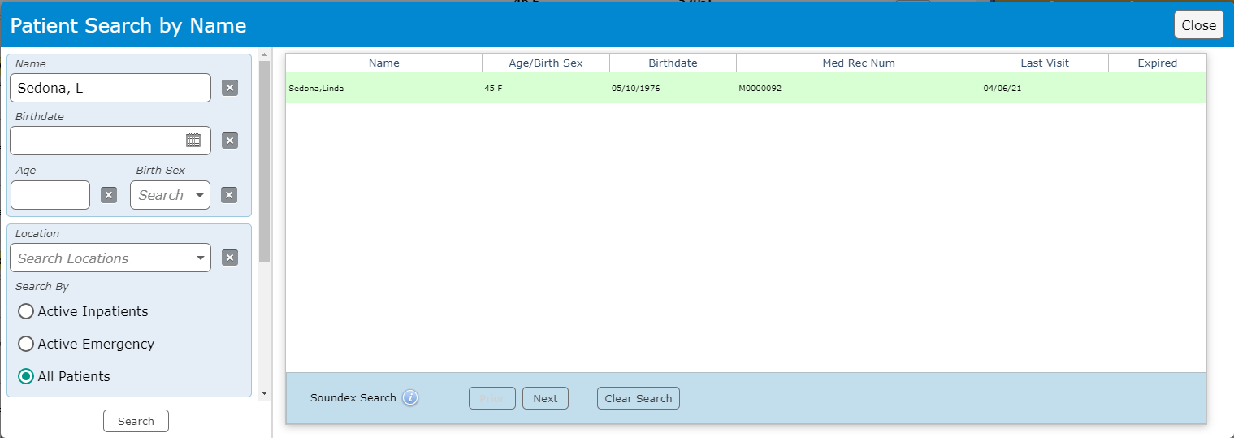
Patient Search
Enter patient name
Resulting pop-up
Filters on left pane
Select desired patient from list

Slide 18
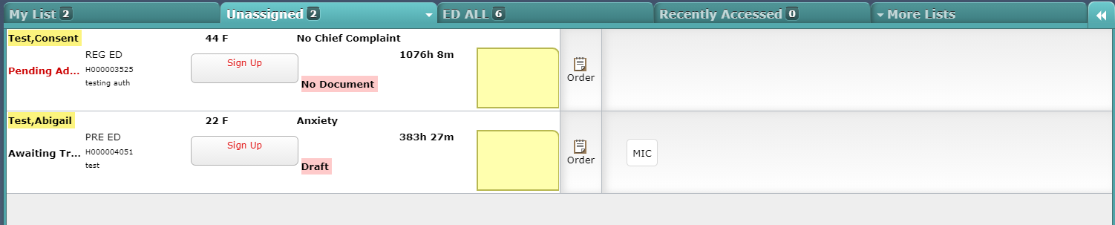
Tabs
“Unassigned”
The starting point to “Sign Up” for patients
A Patient Box
Pt name/Age/Gender/Chief Complaint (if any)
Status
Registration Status/Visit #/Stated reason for visit

Slide 19
Tabs
“Unassigned”
Provider Signup Box
Document Indicator
Time since Registered

Slide 20
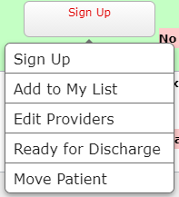
Signing up for Patient
Clicking into Signup Box
“Signup”
  Inserts your name as responsible provider
  Changes the “Status” indicator
  Moves the patient to “My List”
“Add to My List”
  Moves patient to “My List”
  Does NOT change status or insert your name

Slide 21
Disclaimer
Other areas of the patient box will be covered under “My List” Tab, when they are more relevant.

Slide 22
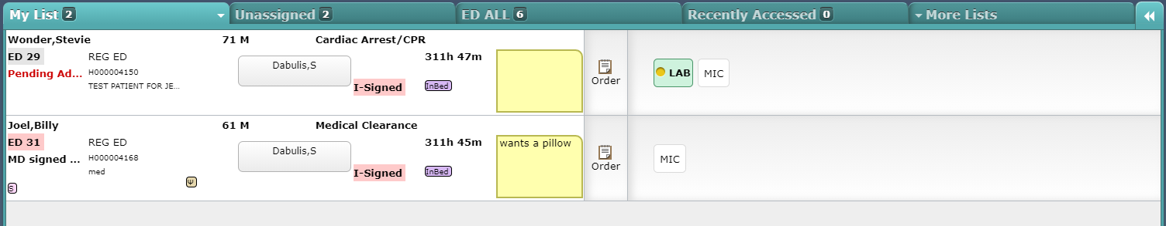
Tabs
“My List”
Your list of patients (Signed up for, or added)
Provider name(s) – MD & Mid Level
Indicators – Psych shown here
Surveillance Indicators – Sepsis, etc.

Slide 23
Tabs
“My List”
Your list of patients (Signed up for, or added)
Communication tool
Quick Link to “Orders”
Order Result Indicator

Slide 24
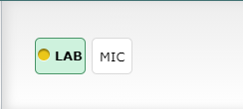
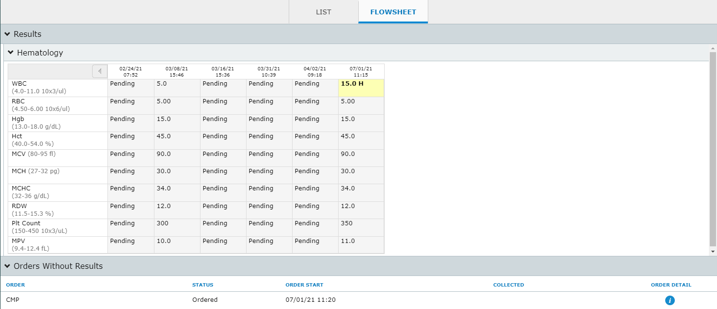
Order Result Indicator
All Orders will generate a Button
  Grey (not resulted)
  Colored (at least partially resulted)
  Color coded (Lab) for abnormal/Critical
Clicking on any button results in “Results” window
Orders without results can be reviewed for their status

Slide 25

Additional Tabs
“ED All”
  All ED patients on one list
“Recently Accessed”
  Charts you have opened (Last 72 hours?)
  Useful to review charts from previous shifts
“More Lists”
  See Additional Functions (next)

Slide 26
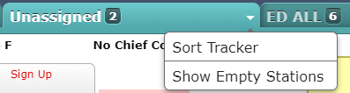
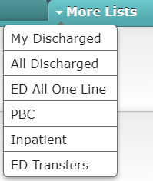
Additional Functions
Selected Tabs have Drop arrows
  Menus include
    Sort Tracker (3 levels of sorting)
    Show Empty Stations (Displays empty patient locations)
      Not available on “My List”
More Lists
  Discharged patients (yours or all)
  Single line view of department
  Inpatient location lists
  ED Transfer List

Slide 27

Additional Functions
Alternative View
  Accessed via “Home” button (previously covered)
  Or the double arrows on Tracker

Slide 28
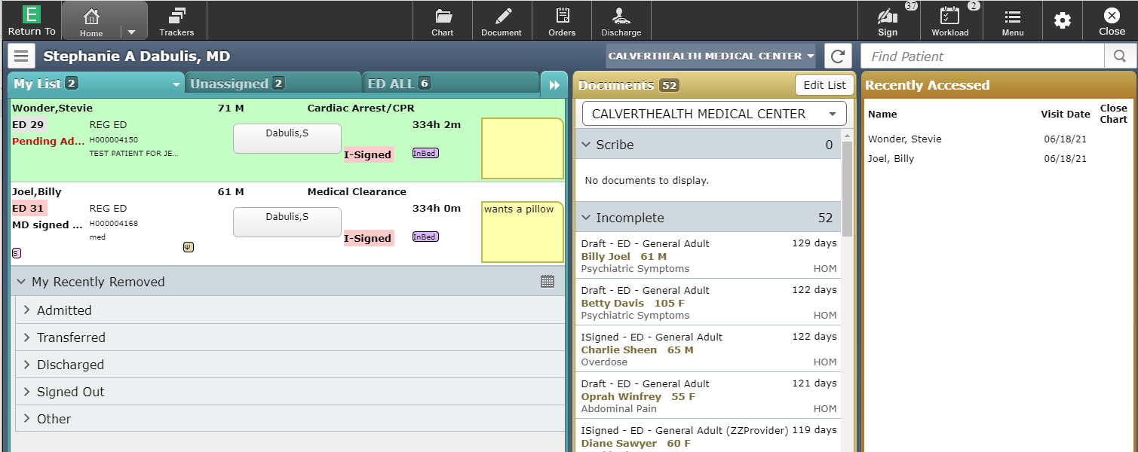
Alternative View
Tracker collapses to half the screen
  You lose The Orders link and results section
  You gain simplified access to other lists

Slide 29
Alternative View
Documents section displays all Incomplete documents
Your recently accessed patients display

Slide 30
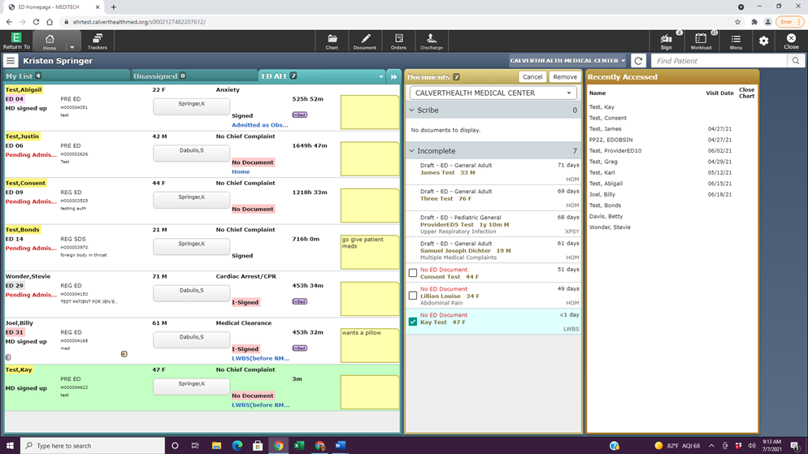
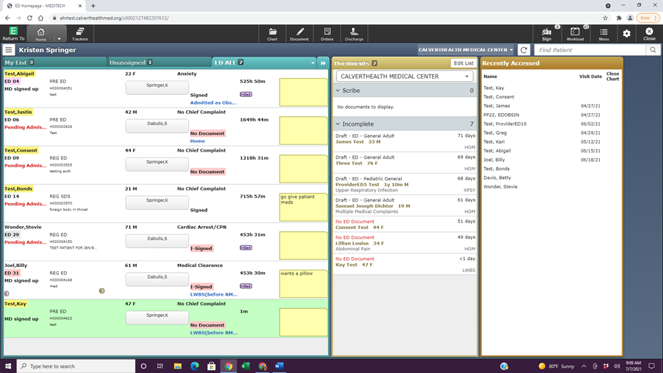
Alternative View
Incomplete Documents
Incomplete Documents may include Errors
Click “Edit List” to correct
Select Documents
Valid documents Not selectable
Remove

Slide 31
The Chart
Chart Navigation

Slide 32
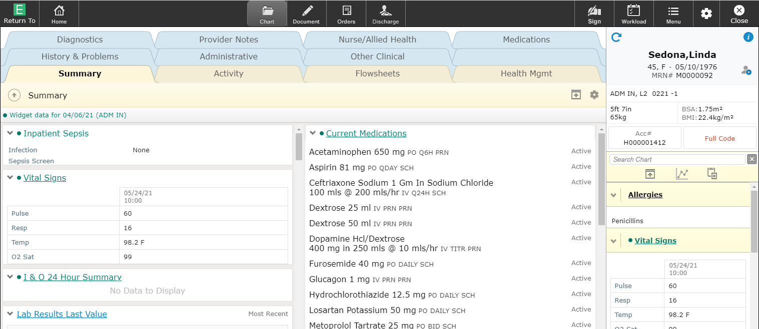
Chart Overview
Chart in Tab View (Left) – Varies based on Tab selected
Reference Panel (Right) – Always open

Slide 33
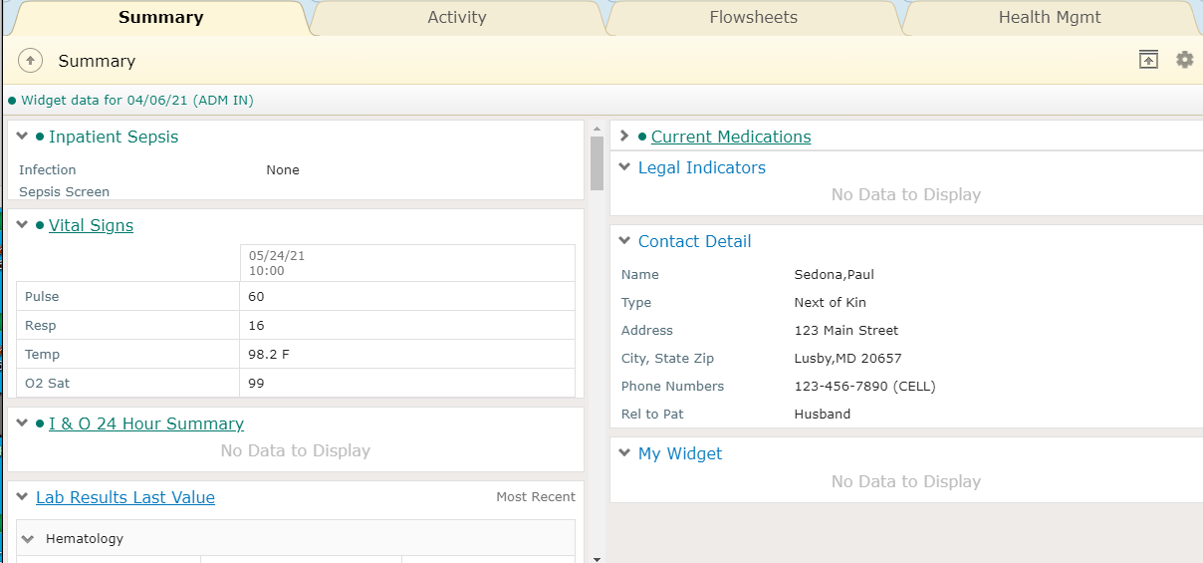
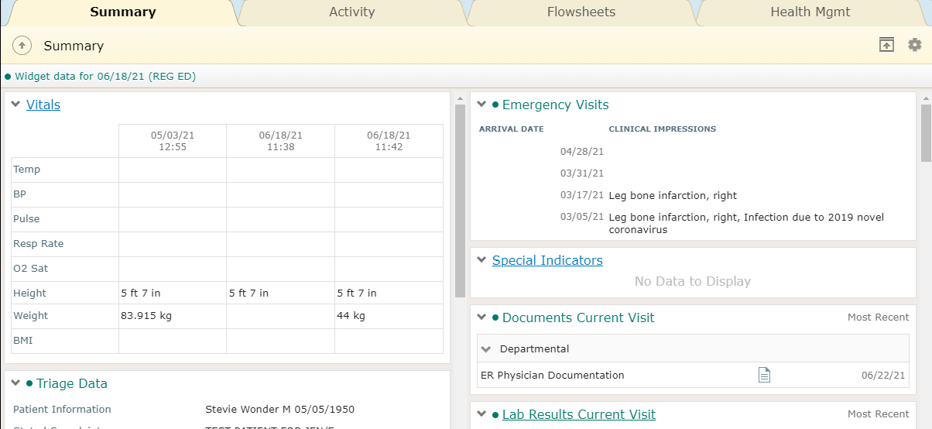
Summary Tab
Collection of Widgets in 2 columns
Click Cogwheel to Edit Widgets

Slide 34
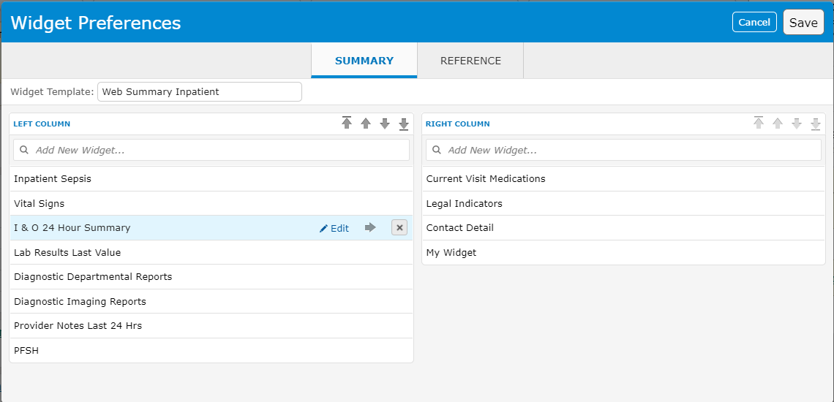
Widget Preferences
Widgets may be
  Added
  Deleted
  Moved (to different column or within list)
**Never Edit**

Slide 35
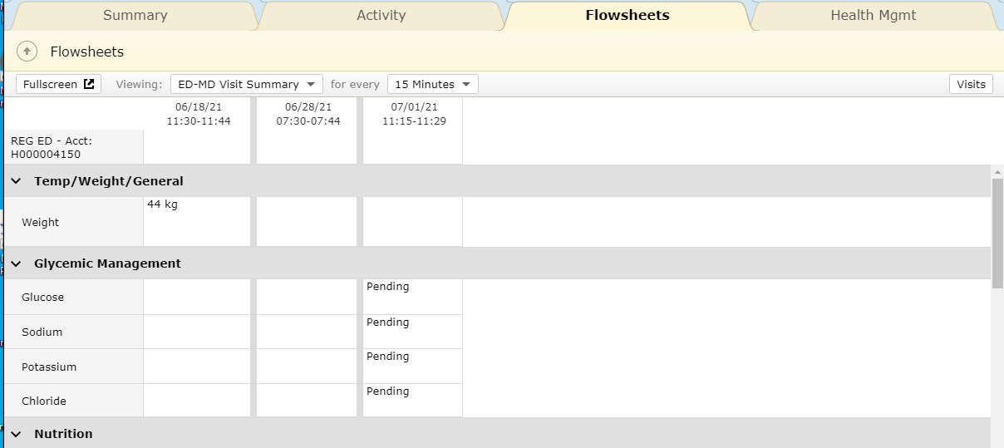
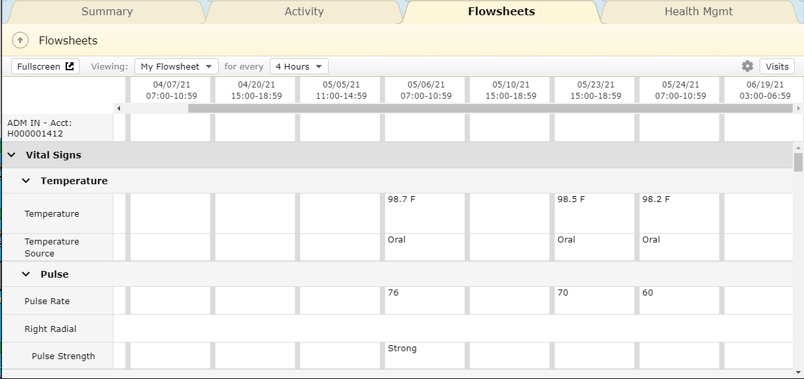
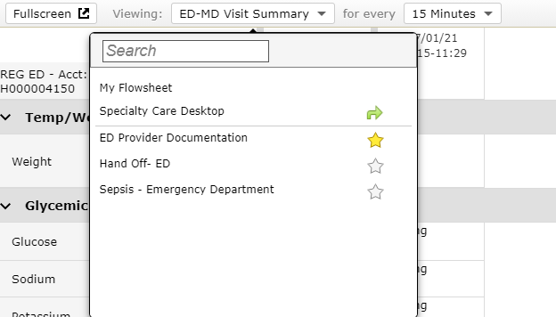
Activity/Flowsheets/Health Mgmt
Activity – Activity Log (Seen previously)
Health Mgmt – Ambulatory, not used
Flowsheets – Temp/Weight, Gycemic Mgmt, Labs,
  Other “Clinical Panels” may be chosen
Yellow star = Favorite

Slide 36
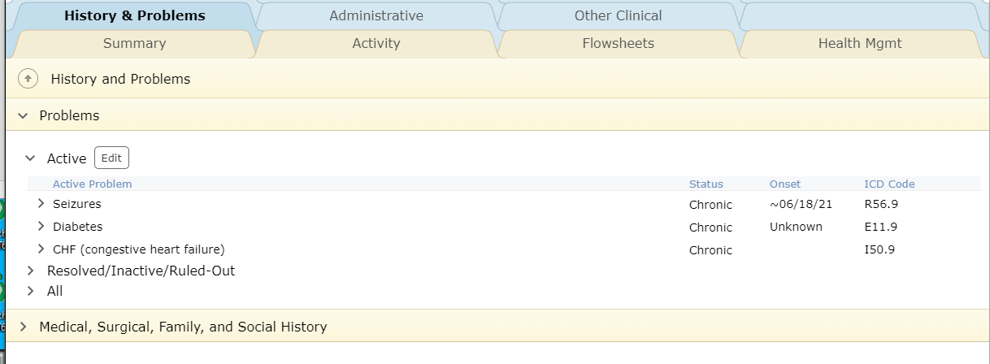
History & Problems/Administration/Other Clinical
History & problems
  Review screen of Problem List
  Better process to Edit within Documents

Slide 37
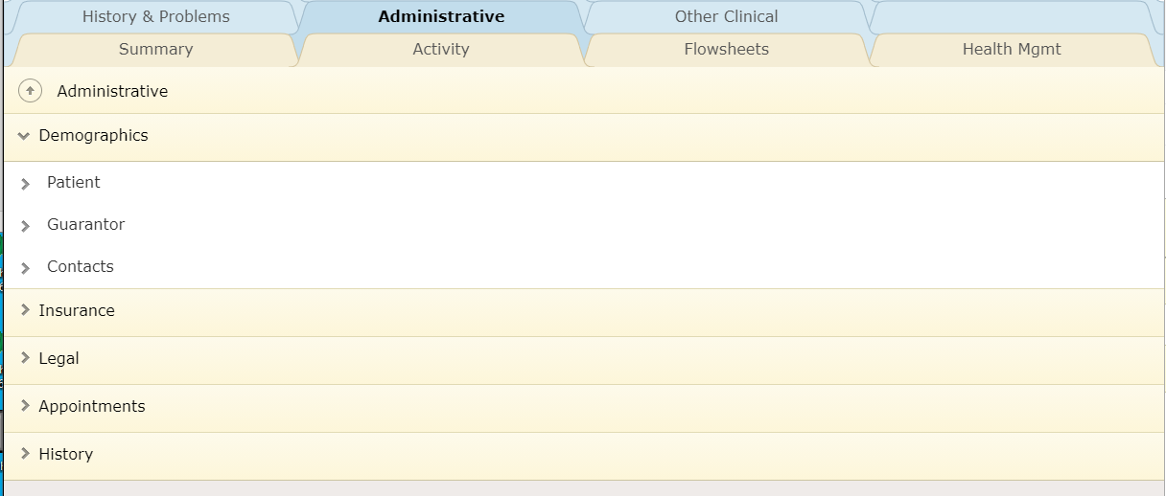
History & Problems/Administration/Other Clinical
Administrative – Registration Information
  “Legal” – Includes MOLST form Hx

Slide 38
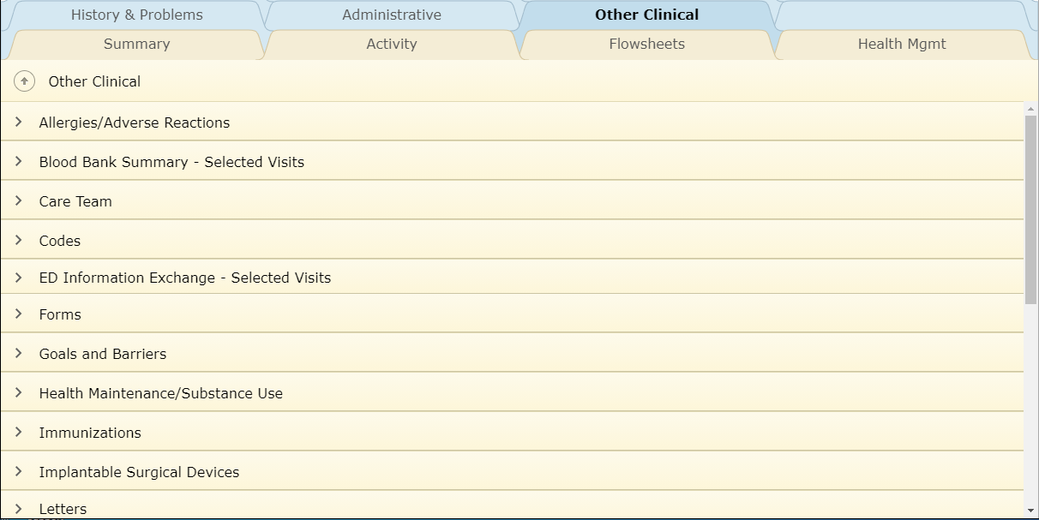
History & Problems/Administration/Other Clinical
Other Clinical
  A collection of all information that didn’t have a designated tab location

Slide 39
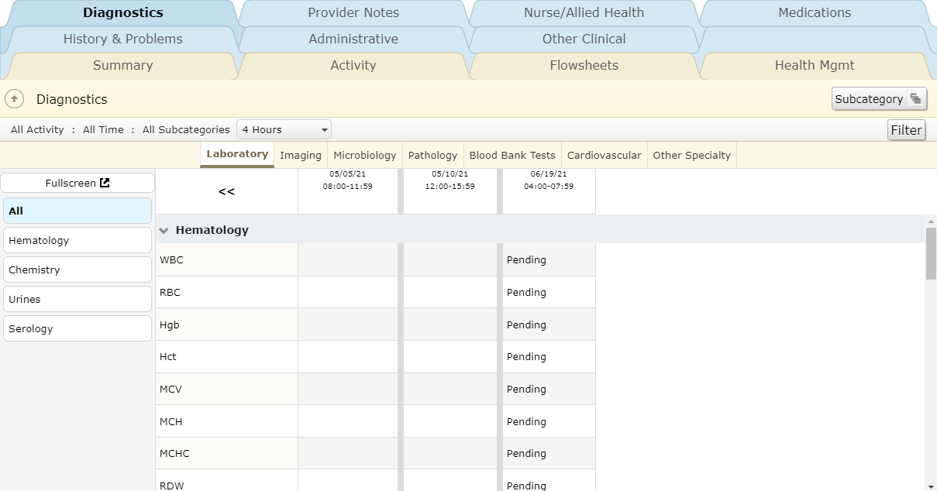
Diagnostics/Provider Notes/Nurse/Allied Health/Medications
Diagnostics
  Click on headers to see specific Specialties
  Left Panel filters view under Lab
Subcategory – best view
  Microorganism- alternative view
Filter – time range/ Inpatient/ subcategory

Slide 40
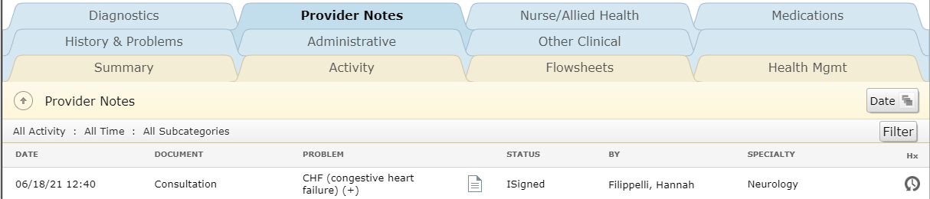
Diagnostics/Provider Notes/Nurse/Allied Health/Medications
Provider Notes
  All Provider Notes display here
  All statuses included (Signed/Draft/Pending)
  Click document icon to open and view document
    Document icon will display a “✓” when viewed

Slide 41
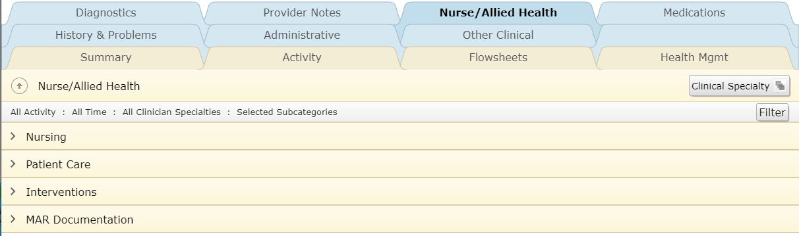
Diagnostics/Provider Notes/Nurse/Allied Health/Medications
Nurse / Allied health
  All non-provider assessments/notes appear here

Slide 42
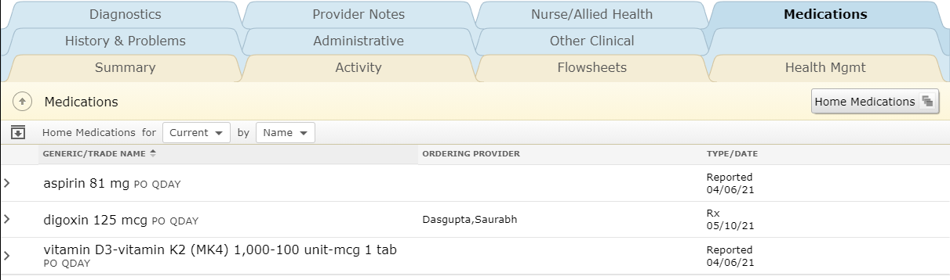
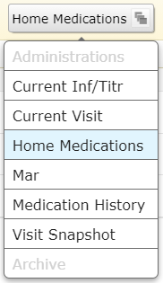
Diagnostics/Provider Notes/Nurse/Allied Health/Medications
Medications
  All medication views are found here

Slide 43
Reference Panel
Patient information that constantly displays
Name/Age/Gender/DOB/Medical Record #
Status/Floor/Room
Height/Weight
  Calculated BSA/BMI
Acct# Button
  Click to select Visit(s)
Resuscitation Status Button
  Displays Code Status (Hx available(?) if not ordered)
  Link to code Status Hx/MOLST Hx
  Able to order/edit Code Status from linked page

Slide 44
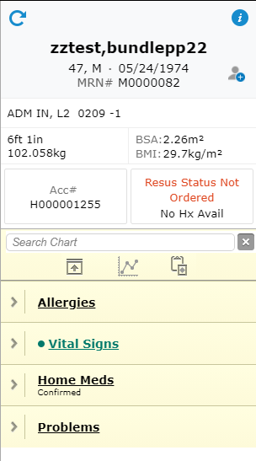
Reference Panel
Search Chart
Locked Widgets
  Collapsed here to display them

Slide 45
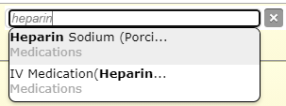
Chart Search
Search Chart
  Type any element in chart (must exist in chart)
  Clickable options display
  Popup results display

Slide 46
Reference Panel Widgets
Box with up arrow
  Collapses and expands widgets
Click Widget Header for more detail
Widget editor (cogwheel on Summary)
  Can add widget(s) below locked 4
**Recommended to always
leave Allergies open**

Slide 47
Document
Introduction to the Document

Slide 48
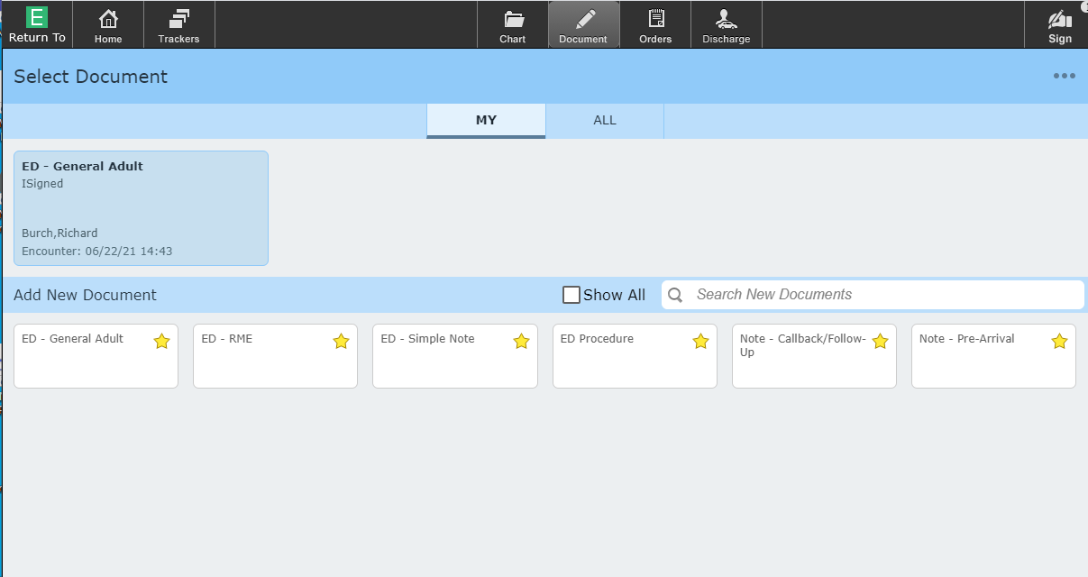
Document
Favorite Documents display (yellow star) to select
Existing (Draft/Pending) display in Grey area under “MY”

Slide 49
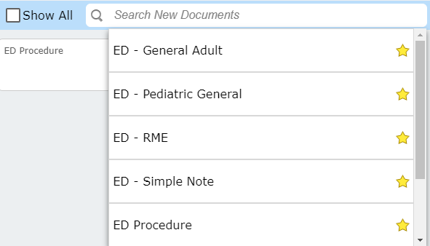
Document
“Show All” – displays all documents with favorites at the top
“Search New Documents” – Displays all ED documents alphabetically
  Click on Star to make it a favorite (Done for you)

Slide 50
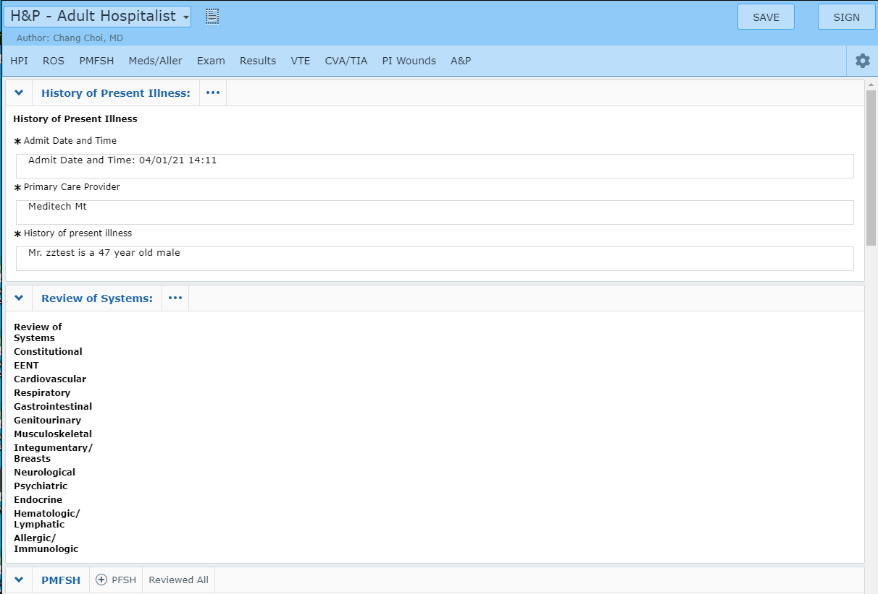
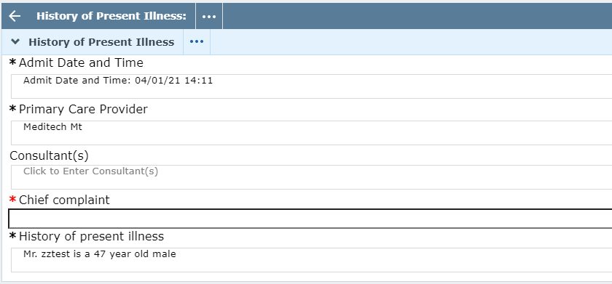
Document
Training on Document details will be done in person
  Header links jump to that location in chart
  Clicking section headers opens them for editing
  HPI shown below in Edit mode (note arrow)
  Save (draft) and Sign options

Slide 51
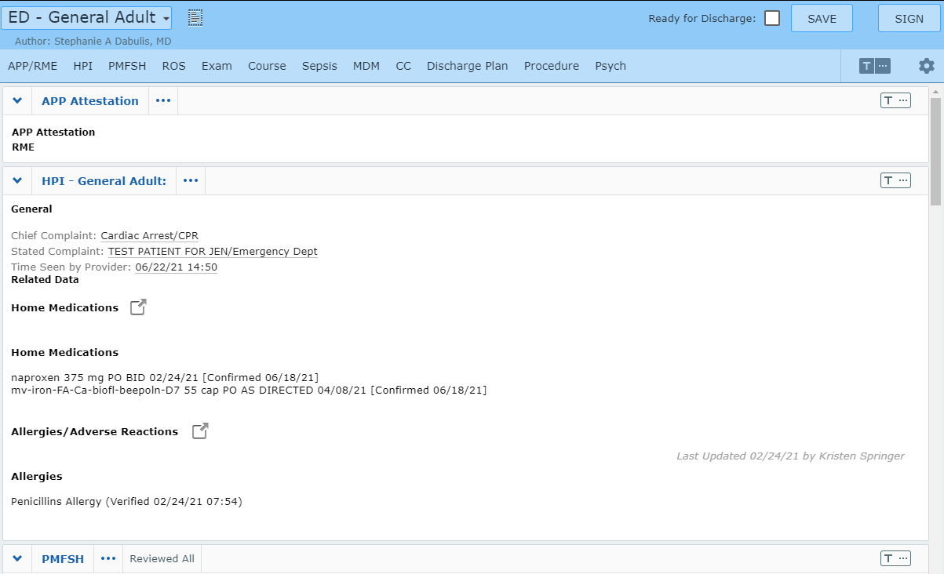
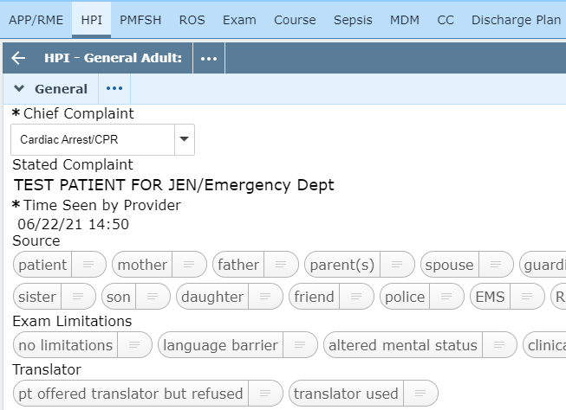
Document
Training on Document details will be done in person
  Header links jump to that location in chart
  Clicking section headers opens them for editing
  HPI shown below in Edit mode (note arrow)
  Save (draft) and Sign options

Slide 52
Orders
Introduction to the Orders screen

Slide 53
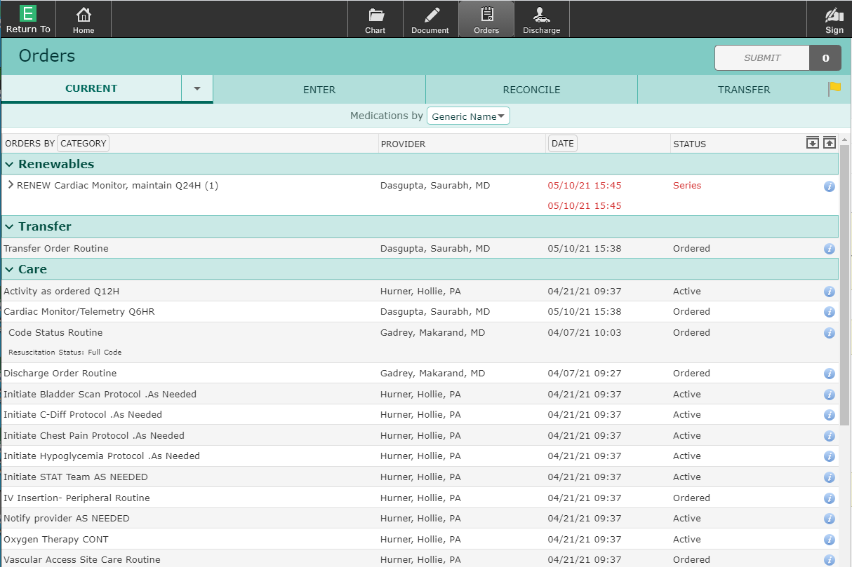
Orders
Current/Enter/Reconcile/Transfer headers display
Drop arrow by Current – Historical and Hold Queue
Yellow Flag on Transfer header – existing orders
Display is “Current
Orders” by category

Slide 54
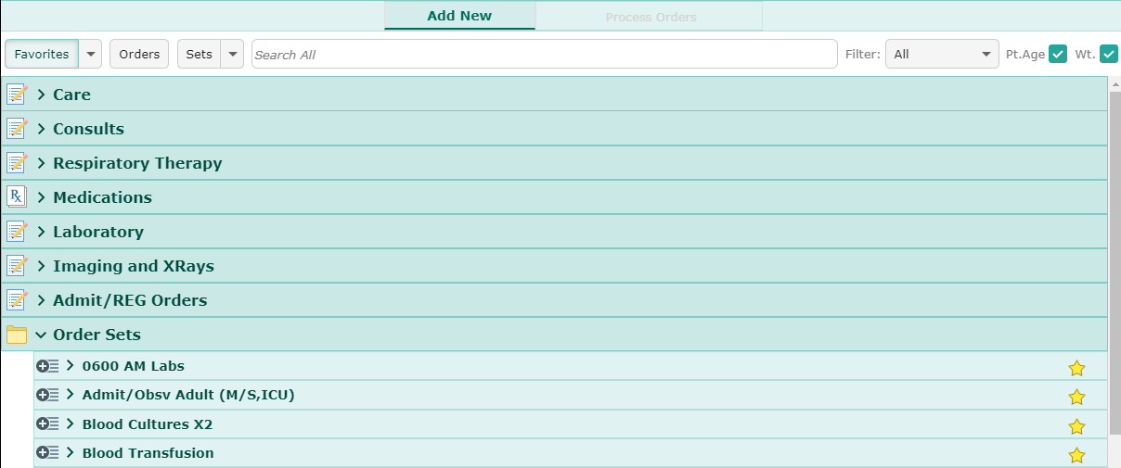
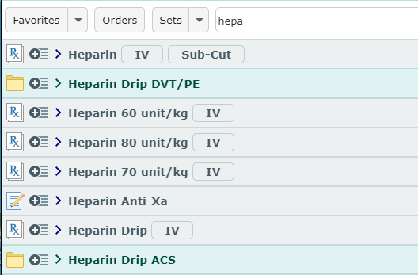
Enter Orders
Default display is “Favorites” (Category)
“Orders” button display all orders by category (collapsed)
“Sets” displays all order sets (May be sorted)
Search displays options (orders/medications/sets)
  When options are not too large
  Heparin search below

Slide 55
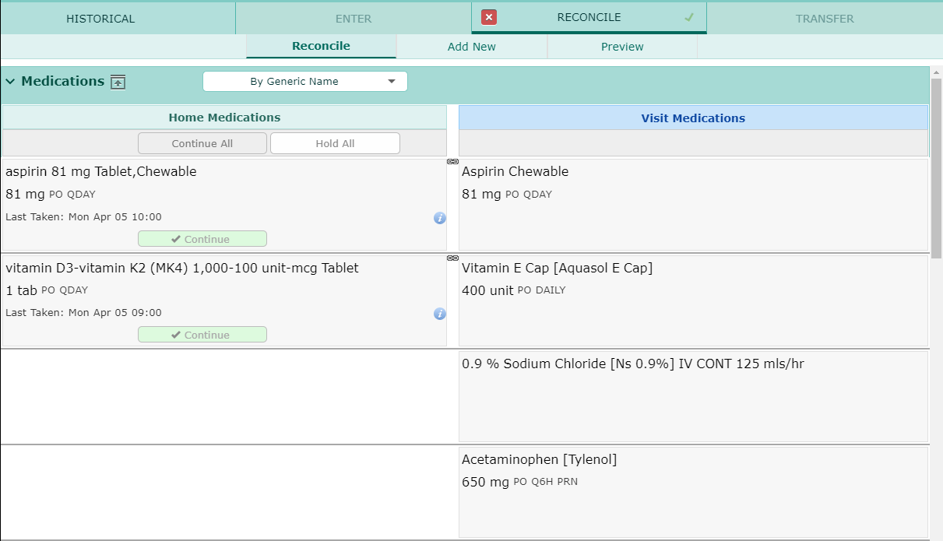
Reconcile
Only done by Admitting providers
Usually done within the Transfer Routine

Slide 56
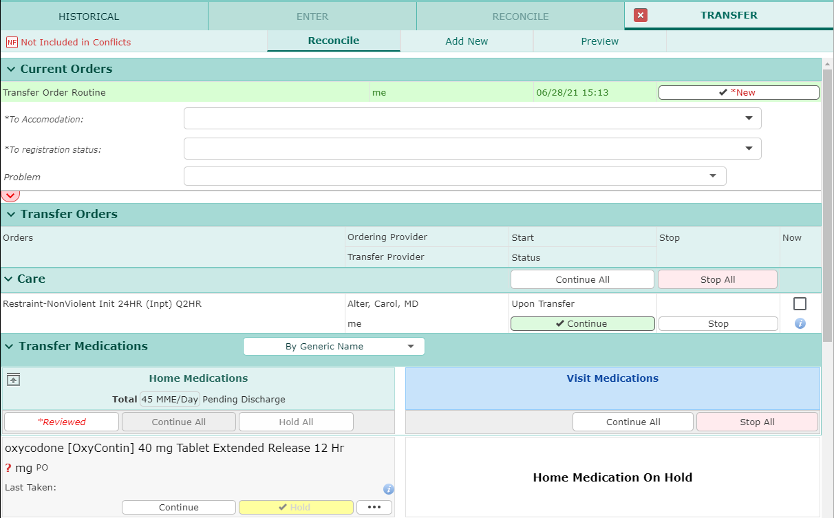
Transfer Routine
By Admitting Provider
Used to transfer patients when level of care changes
Entered as pending orders (Receiving nurse activates)
Transfer order (Registration order)
Existing orders
  Stop/continue
Med Reconciliation
New orders added

Slide 57
Discharge
Introduction to Universal Discharge
Varies based on Patient location (SDS, ED, Admitted)

Slide 58
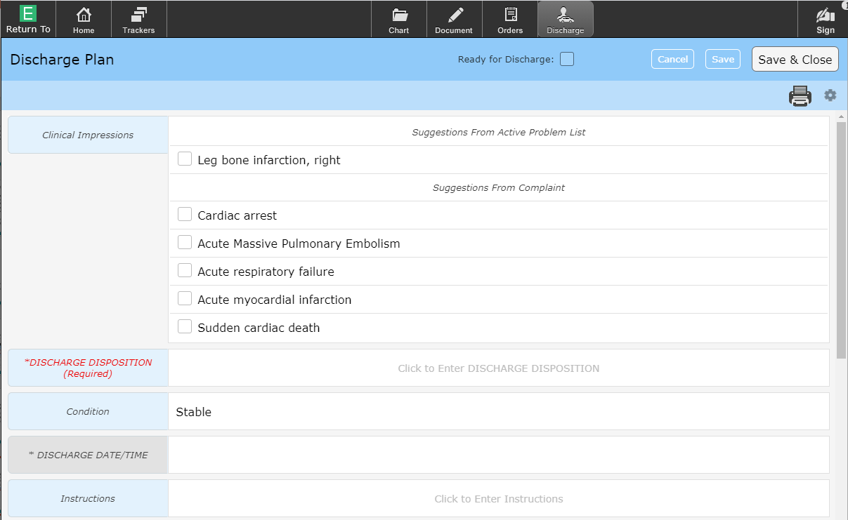
Universal Discharge
Universal Discharge – All clinicians have input into the discharge process
The “Discharge” exists in 2 locations (identical in both locations)
  Under the “Discharge” button
  Discharge Summary Documents
*Red = Required
Grey = Not available
  Based on user

Slide 59
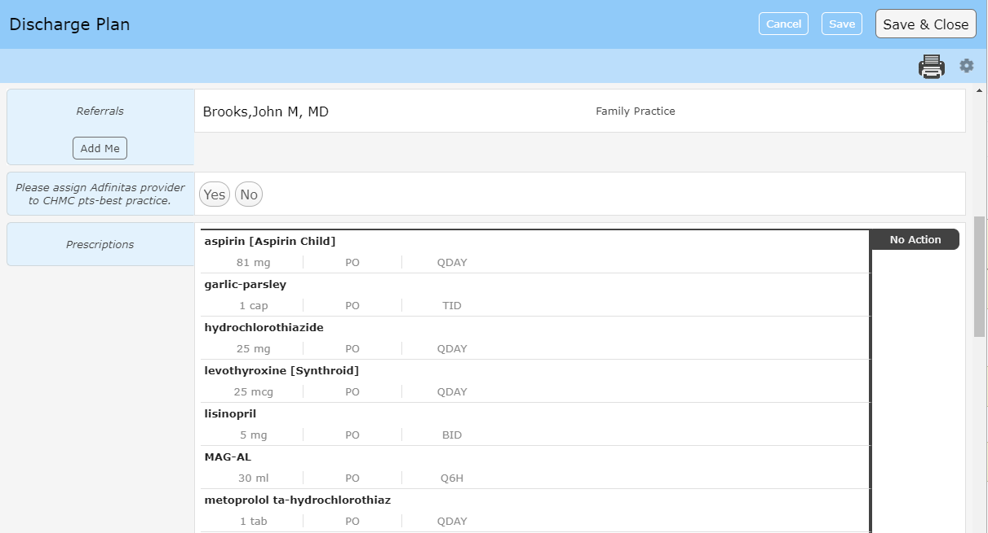
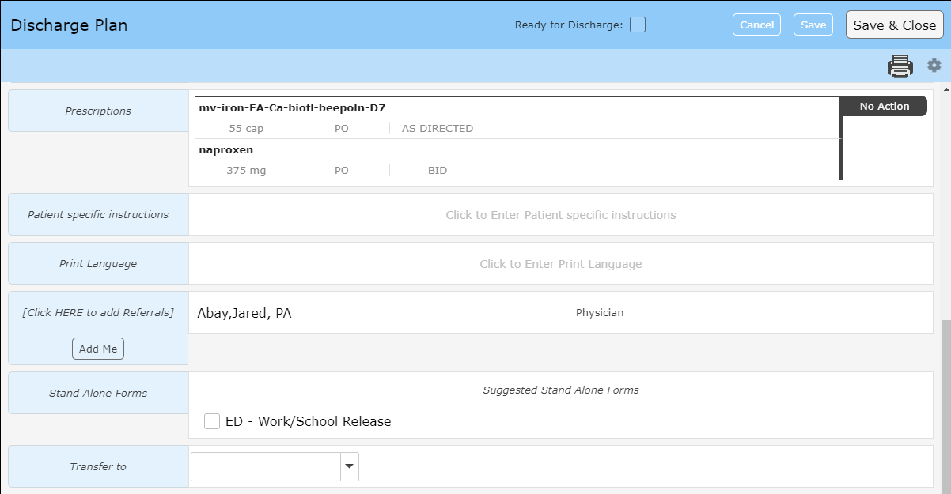
Universal Discharge
Referrals
Discharge Medication Reconciliation
  New Rx’s
Discharge order (not shown)

Slide 60
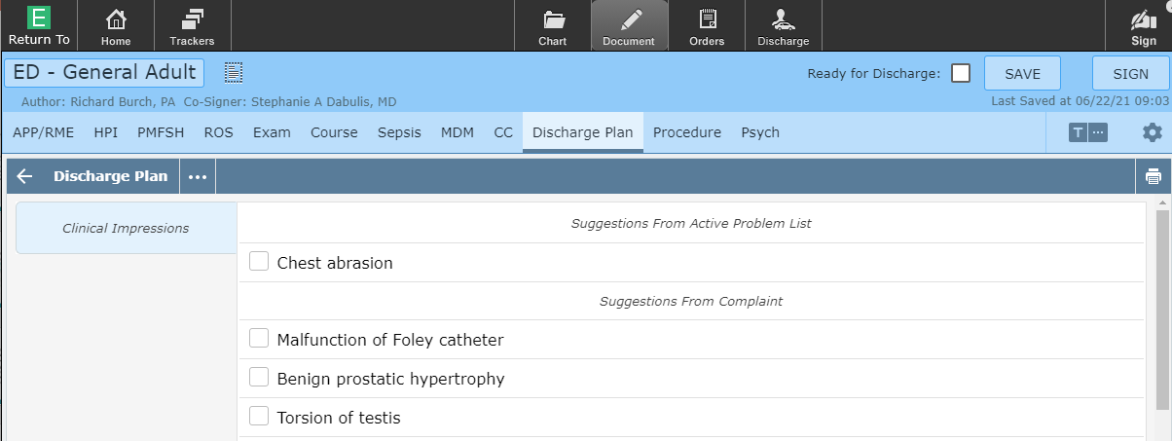
Universal Discharge
Universal Discharge also exists within the ED Document (Identical)
  Added functionality – Ready for Discharge Flag

Slide 61

Thank You
You should have been scheduled for 1 on 1 training
Please call (410)535-8260 or email glenn.heaney@calverthealthmed.org if you have questions

